Slide 1


Proposed Growth Strategy for an Innovative Enterprise
Team Fearless
Renukalaxmi Dudhe
Amuktha Suravarapu
Fazliddin Narzulloev
Mary Lizbeth Rojas
Notes:
To change the image on this slide, select the picture and delete it. Then click the Pictures icon in the placeholder to insert your own image.

Slide 2
Executive summary
Supplier segmentation
Identifying the variables we can impact with a holistic approach
01
Inventory Management
02
Organizational structure
03
Supplier segmentation
04
Sourcing strategy
05
Closing statement

Slide 3
Inventory management
3 years strategy to decrease Service level to 97.5%
Year 1: Service level 99.5%
Discounted pre-orders
Year 2: Service level 97.5-99%
Year 3: Service level 95-97.5%
Service level | Inventory reduction | $ Reduction | Inventory turnover
50 | 45.00% | $710,100.00 | 7.79
84 | 33.75% | $532,575.00 | 6.46
90 | 30.38% | $479,317.50 | 6.15
95 | 27.00% | $426,060.00 | 5.87
97.5 | 22.50% | $355,050.00 | 5.53
99 | 19.13% | $301,792.50 | 5.30
99.5 | 15.75% | $248,535.00 | 5.08
99.99 | 0.00% | $0.00 | 4.28
Notes:
Reduction of SL from 99.99 to 95 over 3 years period
Strategy: 1st year set SL 99.5% ($250k reduction in inventory)
Allocate part of saved 250k to the unmet demand. Discounts for preorders.
2nd year lower SL to 99-97.5%. Put some marketing effort to switch customer to discounted pre ordering
3rd year set the SL of 97.5-95%. Keep promotion of discounted pre ordering.
After 3 years if considerable amount of demand can be shifted into discounted pre ordering then we can decrease SL as low as 95%
Create internal platform for demand forecast and strategic sourcing
Short to midterm: Create internal platform that is fed with internal data and further is fed by data from the customers as well.
Use the platform to calculate where are the possible stock outs might be and use virtual pooling strategy to get available product from the closest available warehouse
Long term make the platform transparent by real time data exchange between all the stakeholders.

Slide 4
Inventory management
01
Internal Platform for demand forecast and strategic sourcing:
Demand calculation using statistical modeling with up-to-date and transparent data
Virtual pooling
Long term: Data Exchange with stakeholders
Virtual pooling
03
02

Slide 5
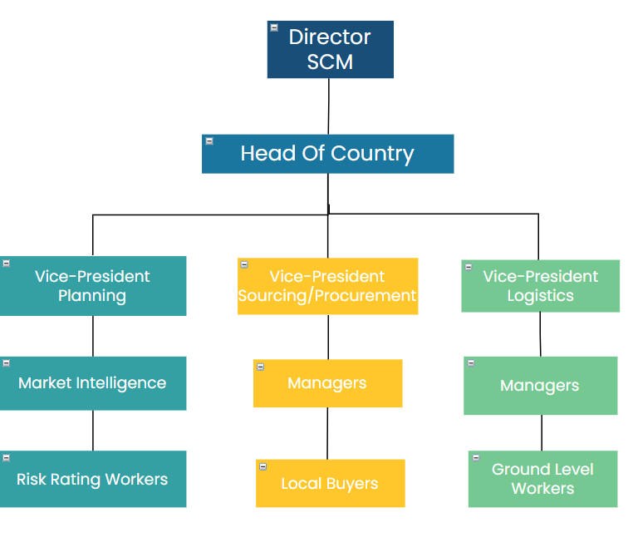
Organizational Structure
Center Led Organizational chart
Management of only necessary roles
New Contracting terms for employees
Goal establishment and Scorecards to determine performance

Slide 6
Calculated Headcount
Specifics | Value
Industry Avg FTE (Supply chain Dept) per billion Revenue ($) | 22
Based in industry-average supply chain strength of e2 -ISM Should have | 187
Actual manpower in supply chain dept of e2 -ISM | 258
Excess FTE over industry avg in supply chain dept | 71
Avg Exp per supply management FTE
Operating Expense ($) | 147795
Salary ($) | 123164
Talent development ($) | 1265
Total exp per supply management FTE ($) | 272224
Total extra expense bore by e2 -ISM in maintaining Excess FTE over industry avg ($) | 19327904

Slide 7
Contracting
FOR EMPLOYEES
Scorecards to determine performance
Operation metrics
Sales Metrics
Compliance Metrics
Commision based salaries - Earnings according to the revenue they generate
Notes:
Scorecards to determine performance:
We can score an employee based on few metrics as follows
Operation metrics: These can include productivity, efficiency, and capacity utilization measures.
Sales Metrics: These can include sales volume, sales growth, and sales conversion rates.
Compliance Metrics: These can include compliance with regulatory requirements and adherence to policies and procedures.
At the end of each quarter, buyers will be evaluated and downsized accordingly based on the scorecards(performance).
Commission based salaries:
The buyer's pay will be following a straight commission policy where they earn a percentage of the revenue they generate. In other words, the buyer earns a commission on each sale they make, without any base salary component.

Slide 8
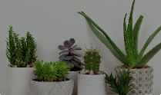

Supplier Segmentation by category
STEP 1
Select suppliers that represent 80%spend
Work with stakeholders to verify the shortlisted suppliers
STEP 3
Apply segmentation tool
STEP 2
Determine supplier critically and risk scores
STEP 4
•Prepare supplier strategy
Incorporate sustainability

Slide 9
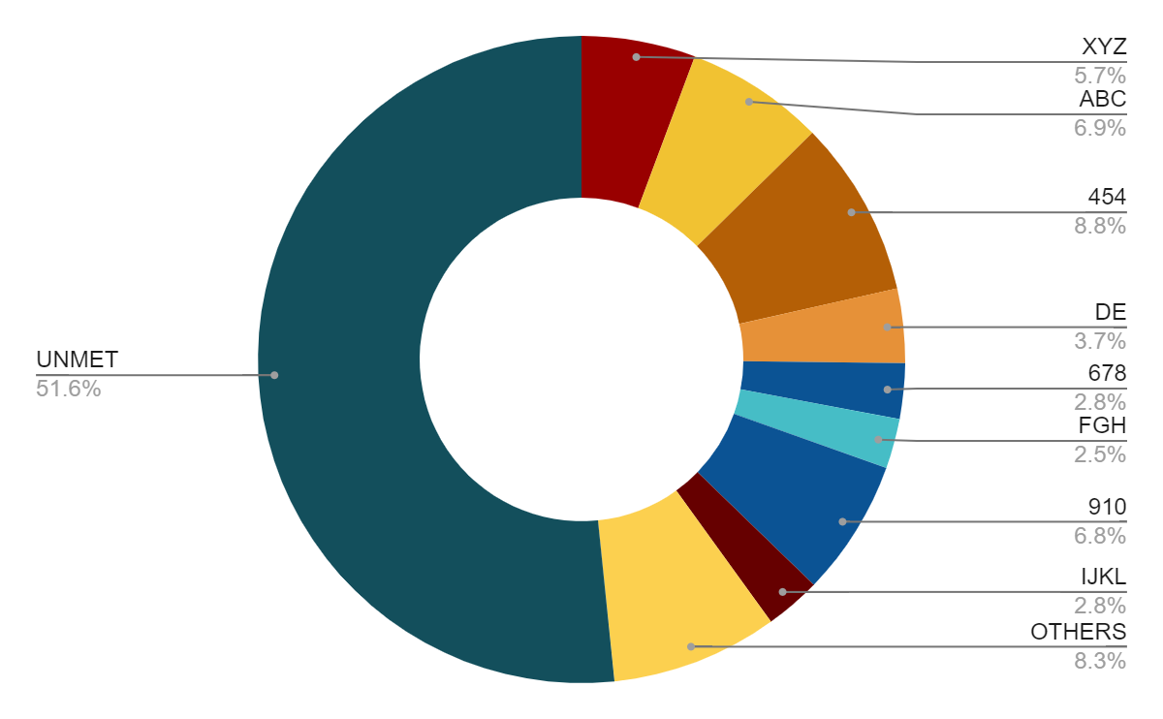



Sourcing Strategy
Strategic alliances for in-house production
Supported by the model Corporation - Cooperative, HR4410 Bill of Congress. Tax benefits are included
Sourcing events
Market intelligence research Evaluate important variables Rate suppliers based on scorecards Contract negotiation
Recycling and re using
1
Recycling and re using potential of REE Joint efforts with suppliers for development and implementation
Upcoming sourcing deficit: “123” leaves gap
2
3

Slide 10
Conclusion
With the management of inventory and service levels we would improve cost savings and increase internal efficiency .
Category management and reorganizing the company's structure allow for a more dynamic and goal-oriented organization.
The implementation of supplier segmentation and a sourcing strategy would allow us to better manage suppliers and the market as well as the external impacts.
Continuous re evaluation and strategy adjustment

Slide 11

Thank you
Team Fearless
Notes:
To change the image on this slide, select the picture and delete it. Then click the Pictures icon in the placeholder to insert your own image.

